Slide 1
CPE631 Final Project Pedsim simulation
Guanghua Zha
5/6/2019

Slide 2
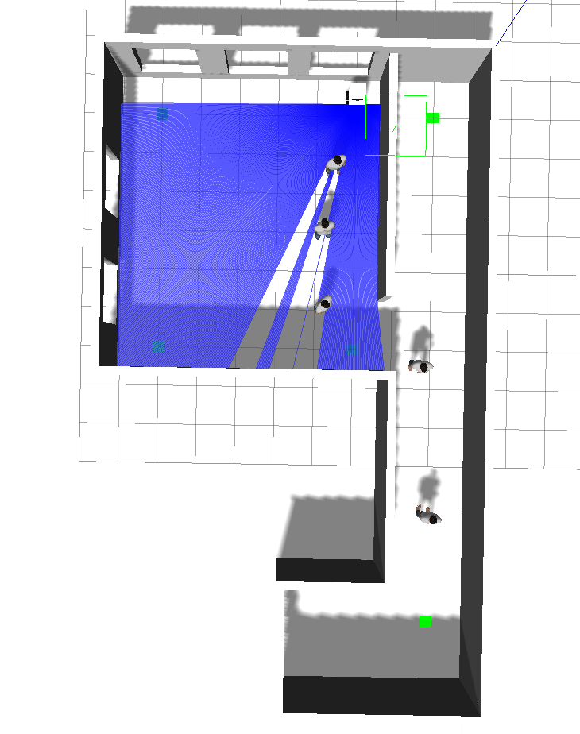
Indoor Navigation
Start position: (1, -3)
Target position: (14,-1)
Several Human-shape model are moving around
Main Goal: Develop a navigation algorithm that reach the goal as fast as possible.
Secondary Goal: minimize human-robot interaction, computational resource usage and predictable robot movement.
Wall Tracker: Robot should try to move along the wall and therefore reduce interaction with human.

Slide 3
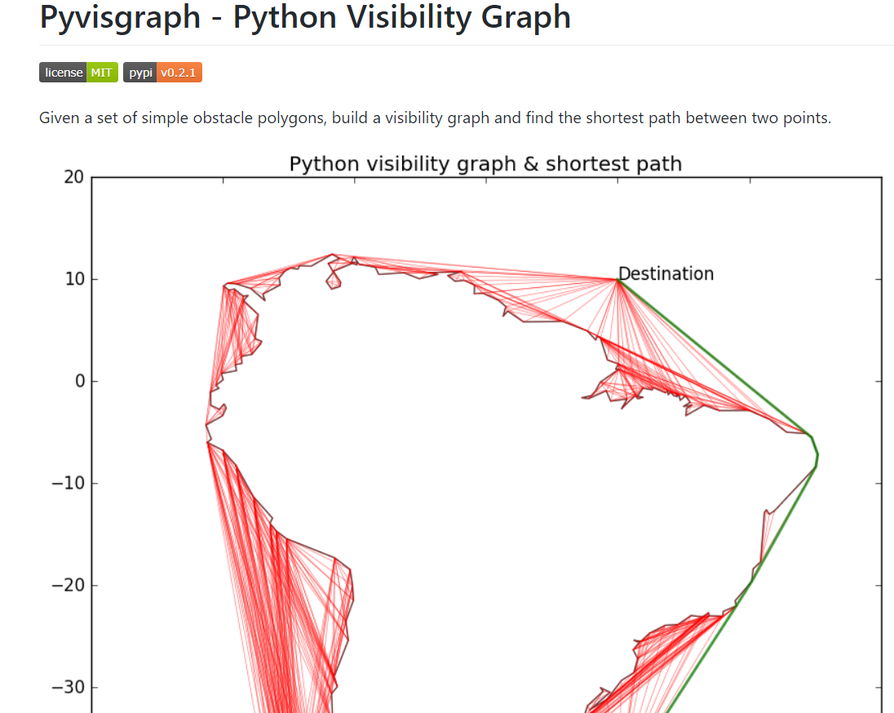
Navigation step by step
Acquire wall location using gazebo interface
Construct visibility graph using python library pyvisgraph
Calculate shortest path

Slide 4
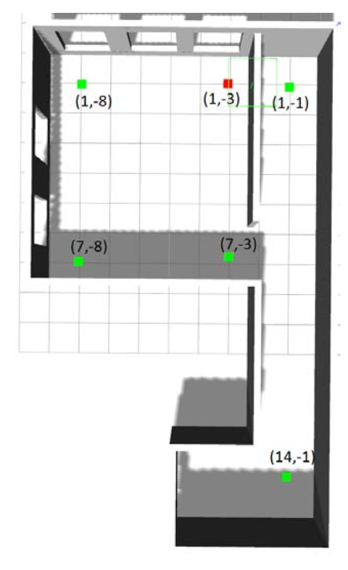
Navigation step by step
Shortest Path: (1,-3), (5, -2.5), (14, -1)
For two adjacent point in the path, if one of the coordinate are the same, the path is a straight line. Otherwise the path is a oblique line.
For oblique line, there are two possible path as shown below. Sample the path and choose the one that contains longer wall.
Result a basin action set that contains all the horizontal and vertical movement

Slide 5
Navigation step by step
Further proceed the action: if the path is too short(<=0.5), replace the pass with the action ‘calibration’
Move the path away from the wall if any wall contains in the path
Adding transaction: 90 degree turn, U turn, S turn
Adding calibration action: if the path is too short or after turning.
Combine everything together. Finatl navigation stack should looks like:
Cali->Forward->Turn->Cali->Forward->Turn->Cali….

Slide 6
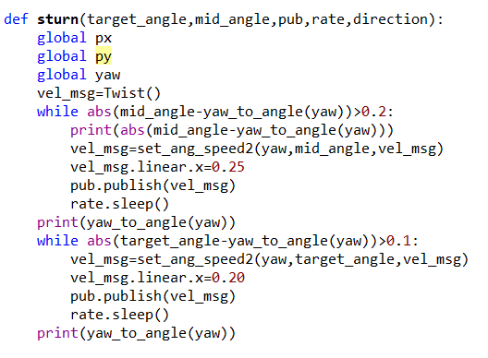
Action space
Define each action using their length, direction, angle in one or more while loop.
Forward, Turn, Sturn, Uturn, Calibration

Slide 7
Result
r1.mp4 16:40-17:14
r2.mp4
r3.mp4 41:10-41:55

Slide 8
Problem and future work
Collide with ‘human’. Usually getting hit from the back.
Adding collision avoidance system using laser scanner data
Avoid dangerous zone in the map
Deal with inaccuracy map
More simulation on complex map
Algorithm complexity analysis. Hopefully lower than A/D star

Slide 9
Question & suggestion?

Slide 10
Thanks!

